Slide 1
Lecture 4: Positive vs. Normative Methods and their Role in Environmental Economics
Prof. Parthum
Environmental Economics Econ 475

Slide 2
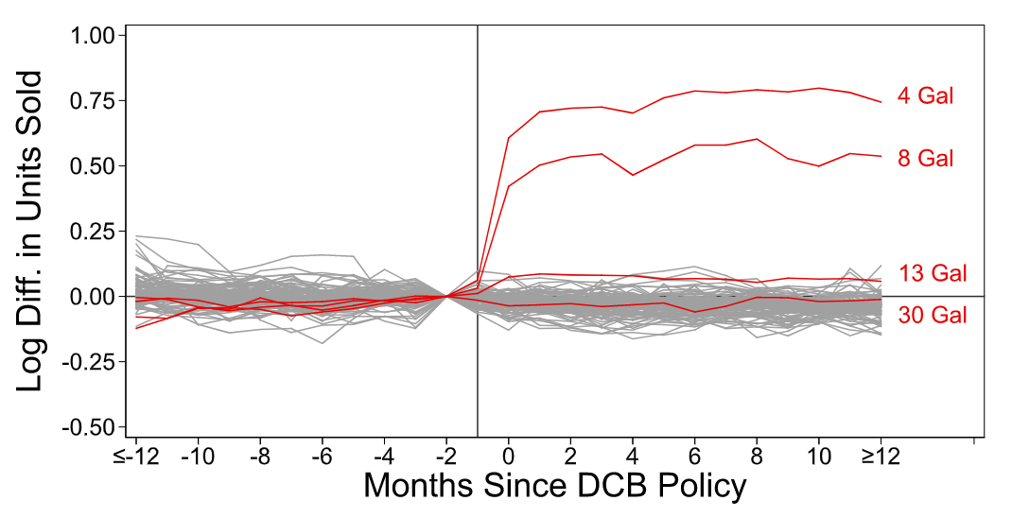
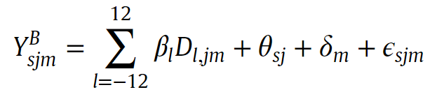
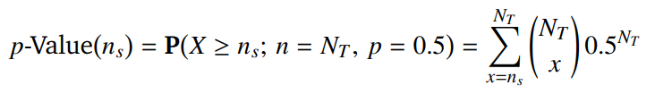
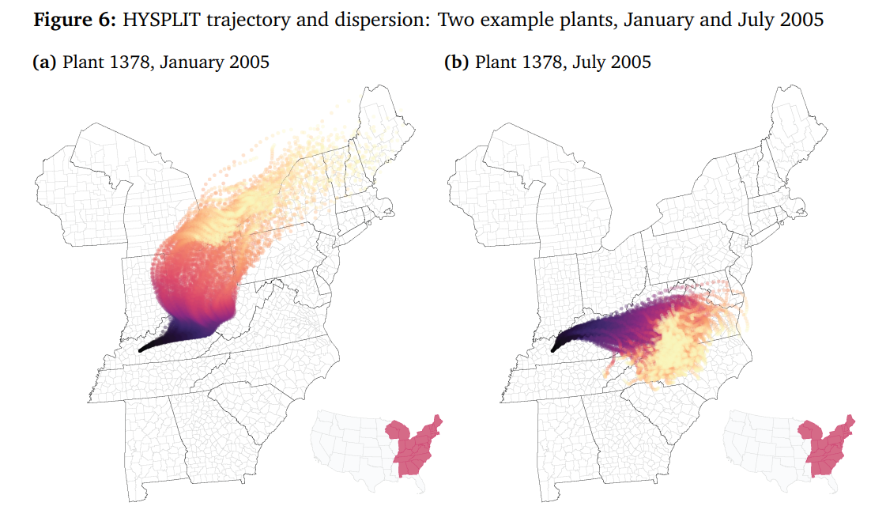
Research Questions in Environmental Economics
Last time we talked about a few real-world market failures and how researchers go about quantifying them
Plastic bags, coal plant emissions, etc.
They combine maths, data, and theory to shine light on externalities
What type of scientific research would you classify this work as? Positive, or normative?

Slide 3
Research Questions in Environmental Economics
Imagine that a policy maker is interested in turning a vacant lot into public park. Public funding is a constraint. What are the types of questions they will be asking?

Slide 4
Research Questions in Environmental Economics
Imagine that a policy maker is interested in turning a vacant lot into public park. Public funding is a constraint. What are the types of questions they will be asking?
What is the value of another park?

Slide 5
Research Questions in Environmental Economics
Imagine that a policy maker is interested in turning a vacant lot into public park. Public funding is a constraint. What are the types of questions they will be asking?
What is the value of another park?
What is the value of another park in this neighborhood?

Slide 6
Research Questions in Environmental Economics
Imagine that a policy maker is interested in turning a vacant lot into public park. Public funding is a constraint. What are the types of questions they will be asking?
What is the value of another park?
What is the value of another park in this neighborhood?
What is the value of another park in this neighborhood and who would benefit from its installation?

Slide 7
Research Questions in Environmental Economics
Imagine that a policy maker is interested in turning a vacant lot into public park. Public funding is a constraint. What are the types of questions they will be asking?
What is the value of another park?
What is the value of another park in this neighborhood?
What is the value of another park in this neighborhood and who would benefit from its installation?
Where should another public park be installed?

Slide 8
Research Questions in Environmental Economics
Environmental economics can be used to answer the quantitative research questions related to the public park.

Slide 9
Research Questions in Environmental Economics
Environmental economics can be used to answer the quantitative research questions related to the public park.
Using data, theory, and maths, economists can provide really important information to the decision makers.

Slide 10
Research Questions in Environmental Economics
Environmental economics can be used to answer the quantitative research questions related to the public park.
Using data, theory, and maths, economists can provide really important information to the decision makers.
But what about the “should” part of the question. How can environmental economists help inform these decisions? Can they?

Slide 11
Research Questions in Environmental Economics
Environmental economics can be used to answer the quantitative research questions related to the public park.
Using data, theory, and maths, economists can provide really important information to the decision makers.
But what about the “should” part of the question. How can environmental economists help inform these decisions? Can they?
At the federal level, there are additional constraints that decision makers face with respect to making decisions based on race, ethnicity, gender, religion, etc.

Slide 12
Research Questions in Environmental Economics
“…the economic value of an ecosystem function or service relates only to the contribution it makes to human welfare, where human welfare is measured in terms of each individual’s own assessment of [their] well-being. Of course, this is not the only possible concept of value, nor is it always the most relevant. But for purposes of benefit-cost analysis in assessing policy options and for purposes of determining liability when natural resources have been harmed, this concept has considerable precedence as well as legal standing.”
Nancy Bockstael et al. (2000): On Measuring Economic Values for Nature

Slide 13
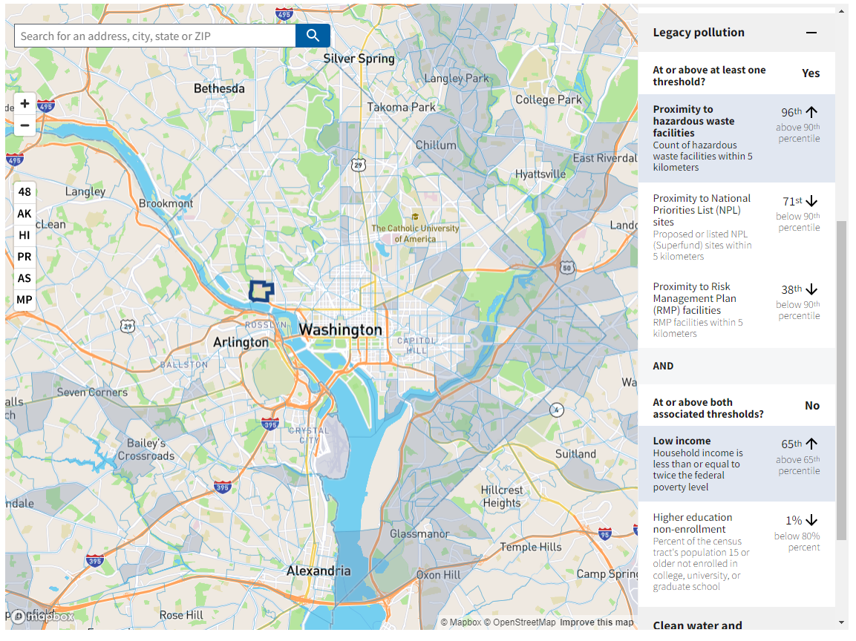
Normative Assertions in Environmental Policy
In 2022, the Center for Environmental Quality (CEQ) released a tool to help inform policy decisions related to the human-environment relationship
The Climate and Economic Justice Screening Tool (CEJST)

Slide 14
Normative Assertions in Environmental Policy
“…A tool that doesn’t explicitly account for race risks missing moderate-income communities of color that have nonetheless suffered from disproportionate impacts of pollution due to a history of racist land-use decisions — and bear the public health scars to go along with it.” - Sacoby Wilson, Baltimore Sun (2022)

Slide 15
Quality Science for Quality Decisions: Protecting the Scientific Integrity of Benefit–Cost Analysis (here)
By: Dr. Al McGartland (US EPA)
Abstract: Benefit–cost analysis (BCA) provides important science to inform regulatory decision-making. Ideally, the BCA should be based on science, including economics. However, the prominent role of BCA in the policy-making process also creates an incentive to adopt practices that produce results that support a preferred policy. Indeed, rather than informing decision-making, BCA can become a tool for justifying a decision that is made by manipulating results in ways contrary to good science. This article identifies two challenges that threaten the scientific integrity of a BCA because they allow normative and policy judgments to enter into the BCA. The article concludes by identifying actions to help protect the scientific integrity of BCA.

Slide 16
Quality Science for Quality Decisions: Protecting the Scientific Integrity of Benefit–Cost Analysis (here)
By: Dr. Al McGartland (US EPA)
Abstract: Benefit–cost analysis (BCA) provides important science to inform regulatory decision-making. Ideally, the BCA should be based on science, including economics. However, the prominent role of BCA in the policy-making process also creates an incentive to adopt practices that produce results that support a preferred policy. Indeed, rather than informing decision-making, BCA can become a tool for justifying a decision that is made by manipulating results in ways contrary to good science. This article identifies two challenges that threaten the scientific integrity of a BCA because they allow normative and policy judgments to enter into the BCA. The article concludes by identifying actions to help protect the scientific integrity of BCA.

Slide 17
Quality Science for Quality Decisions: Protecting the Scientific Integrity of Benefit–Cost Analysis (here)
By: Dr. Al McGartland (US EPA)
Abstract: Benefit–cost analysis (BCA) provides important science to inform regulatory decision-making. Ideally, the BCA should be based on science, including economics. However, the prominent role of BCA in the policy-making process also creates an incentive to adopt practices that produce results that support a preferred policy. Indeed, rather than informing decision-making, BCA can become a tool for justifying a decision that is made by manipulating results in ways contrary to good science. This article identifies two challenges that threaten the scientific integrity of a BCA because they allow normative and policy judgments to enter into the BCA. The article concludes by identifying actions to help protect the scientific integrity of BCA.

Slide 18
Quality Science for Quality Decisions: Protecting the Scientific Integrity of Benefit–Cost Analysis (here)
By: Dr. Al McGartland (US EPA)
Abstract: Benefit–cost analysis (BCA) provides important science to inform that is made by manipulating results in ways contrary to good science. regulatory decision-making. Ideally, the BCA should be based on science, including economics. However, the prominent role of BCA in the policy-making process also creates an incentive to adopt practices that produce results that support a preferred policy. Indeed, rather than informing decision-making, BCA can become a tool for justifying a decision This article identifies two challenges that threaten the scientific integrity of a BCA because they allow normative and policy judgments to enter into the BCA. The article concludes by identifying actions to help protect the scientific integrity of BCA.

Slide 19
Quality Science for Quality Decisions: Protecting the Scientific Integrity of Benefit–Cost Analysis (here)
By: Dr. Al McGartland (US EPA)
Abstract: Benefit–cost analysis (BCA) provides important science to inform that is made by manipulating results in ways contrary to good science. regulatory decision-making. Ideally, the BCA should be based on science, including economics. However, the prominent role of BCA in the policy-making process also creates an incentive to adopt practices that produce results that support a preferred policy. Indeed, rather than informing decision-making, BCA can become a tool for justifying a decision This article identifies two challenges that threaten the scientific integrity of a BCA because they allow normative and policy judgments to enter into the BCA. The article concludes by identifying actions to help protect the scientific integrity of BCA.

Slide 20
Quality Science for Quality Decisions: Protecting the Scientific Integrity of Benefit–Cost Analysis (here)
Challenge One: Embedding Opaque Science Policy in BCAs
What was provided as an example of science policy?

Slide 21
Quality Science for Quality Decisions: Protecting the Scientific Integrity of Benefit–Cost Analysis (here)
Challenge One: Embedding Opaque Science Policy in BCAs
What was provided as an example of science policy?
Decision trees that outline how to address uncertainty and risk in the context of scientific extrapolations. For example, taking upper bound risk estimates in lab animals (derived using a positive framework) to extrapolate to human population as a “conservative” approach

Slide 22
Quality Science for Quality Decisions: Protecting the Scientific Integrity of Benefit–Cost Analysis (here)
Challenge One: Embedding Opaque Science Policy in BCAs
What was provided as an example of science policy?
Decision trees that outline how to address uncertainty and risk in the context of scientific extrapolations. For example, taking upper bound risk estimates in lab animals (derived using a positive framework) to extrapolate to human population as a “conservative” approach
Challenge Two: Disregarding the Theoretical Underpinnings of BCA

Slide 23
Quality Science for Quality Decisions: Protecting the Scientific Integrity of Benefit–Cost Analysis (here)
Challenge One: Embedding Opaque Science Policy in BCAs
What was provided as an example of science policy?
Decision trees that outline how to address uncertainty and risk in the context of scientific extrapolations. For example, taking upper bound risk estimates in lab animals (derived using a positive framework) to extrapolate to human population as a “conservative” approach
Challenge Two: Disregarding the Theoretical Underpinnings of BCA
The original theoretical underpinnings of BCA rest on the Kaldor–Hicks criterion—that is, for any given policy option, could those who gain from an economic change compensate the losers and still be better off than before? The use of this criterion to assess such a potential Pareto improvement is a positive scientific exercise that requires relying on a consumer sovereignty principle in assessing benefits and costs.

Slide 24
Quality Science for Quality Decisions: Protecting the Scientific Integrity of Benefit–Cost Analysis (here)
Distributional Analysis and Environmental Justice Issues
“Although many economists, lawyers, and policy analysts have advocated for changes to BCA to give greater weight to benefits or costs that accrue to low-income or other disadvantaged subpopulations (Adler 2016), I believe that these important concerns would be buried in the analysis and, ultimately, less transparent.”
“Trying to address both efficiency and distributional justice issues within one framework shortchanges both issues.”

Slide 25
Efficiently Unequal: The Global Rise of Kaldor-Hicks Neoliberalism (here)
By: Dr. Eli Cook
Abstract: This paper offers a history of the “Kaldor-Hicks” concept of economic efficiency from its European birth in the 1930s to its American resurgence in the 1970s to its widespread implementation in the Global South by the early twenty-first century. While philosophers, economists and legal theorists have written widely about Kaldor-Hicks – global-minded intellectual historians have not. As a result, scholars have yet to place its creation, dissemination and ascendency into a broader historical context or examine the reasons behind its global spread. As this paper will demonstrate through the rise of cost-benefit analyses based on “willingness to pay” metrics, while Kaldor-Hicks efficiency was invented by neoclassical economists in the late 1930s, its ascent to policy dominance is part-and-parcel of the neoliberal revolution of the past half century. Linking the history of economic thought with the rise of global neoliberalism, this paper demonstrates how Kaldor-Hicks efficiency emerged as a central pillar of a new, interventionist, wealth-maximizing and market-based form of depoliticized technocratic governance that not only marginalizes distributive concerns but actively exacerbates the problem of global inequality.

Slide 26
Efficiently Unequal: The Global Rise of Kaldor-Hicks Neoliberalism (here)
By: Dr. Eli Cook
Abstract: This paper offers a history of the “Kaldor-Hicks” concept of economic efficiency from its European birth in the 1930s to its American resurgence in the 1970s to its widespread implementation in the Global South by the early twenty-first century. While philosophers, economists and legal theorists have written widely about Kaldor-Hicks – global-minded intellectual historians have not. As a result, scholars have yet to place its creation, dissemination and ascendency into a broader historical context or examine the reasons behind its global spread. As this paper will demonstrate through the rise of cost-benefit analyses based on “willingness to pay” metrics, while Kaldor-Hicks efficiency was invented by neoclassical economists in the late 1930s, its ascent to policy dominance is part-and-parcel of the neoliberal revolution of the past half century. Linking the history of economic thought with the rise of global neoliberalism, this paper demonstrates how Kaldor-Hicks efficiency emerged as a central pillar of a new, interventionist, wealth-maximizing and market-based form of depoliticized technocratic governance that not only marginalizes distributive concerns but actively exacerbates the problem of global inequality.

Slide 27
Efficiently Unequal: The Global Rise of Kaldor-Hicks Neoliberalism (here)
By: Dr. Eli Cook
Abstract: This paper offers a history of the “Kaldor-Hicks” concept of economic efficiency from its European birth in the 1930s to its American resurgence in the 1970s to its widespread implementation in the Global South by the early twenty-first century. While philosophers, economists and legal theorists have written widely about Kaldor-Hicks – global-minded intellectual historians have not. As a result, scholars have yet to place its creation, dissemination and ascendency into a broader historical context or examine the reasons behind its global spread. As this paper will demonstrate through the rise of cost-benefit analyses based on “willingness to pay” metrics, while Kaldor-Hicks efficiency was invented by neoclassical economists in the late 1930s, its ascent to policy dominance is part-and-parcel of the neoliberal revolution of the past half century. Linking the history of economic thought with the rise of global neoliberalism, this paper demonstrates how Kaldor-Hicks efficiency emerged as a central pillar of a new, interventionist, wealth-maximizing and market-based form of depoliticized technocratic governance that not only marginalizes distributive concerns but actively exacerbates the problem of global inequality.

Slide 28
Efficiently Unequal: The Global Rise of Kaldor-Hicks Neoliberalism (here)
By: Dr. Eli Cook
Abstract: This paper offers a history of the “Kaldor-Hicks” concept of economic efficiency from its European birth in the 1930s to its American resurgence in the 1970s to its widespread implementation in the Global South by the early twenty-first century. While philosophers, economists and legal theorists have written widely about Kaldor-Hicks – global-minded intellectual historians have not. As a result, scholars have yet to place its creation, dissemination and ascendency into a broader historical context or examine the reasons behind its global spread. As this paper will demonstrate through the rise of cost-benefit analyses based on “willingness to pay” metrics, while Kaldor-Hicks efficiency was invented by neoclassical economists in the late 1930s, its ascent to policy dominance is part-and-parcel of the neoliberal revolution of the past half century. Linking the history of economic thought with the rise of global neoliberalism, this paper demonstrates how Kaldor-Hicks efficiency emerged as a central pillar of a new, interventionist, wealth-maximizing and market-based form of depoliticized technocratic governance that not only marginalizes distributive concerns but actively exacerbates the problem of global inequality.

Slide 29
Efficiently Unequal: The Global Rise of Kaldor-Hicks Neoliberalism (here)
By: Dr. Eli Cook
“Yet despite what many of these practitioners are taught, the Kaldor-Hicks star around which so many regulatory and policy decisions now orbit is not a value neutral or objective methodology but rather, as seen in the Panamanian example above, a powerful – and yet oft-overlooked – intellectual engine of global inequality.”
“[Kaldor] concluded that economists must support reforms that “allow of compensation to balance that loss, and they will still show a net advantage.” Yet just like Kaldor this was only a hypothetical balancing test.”

Slide 30
Efficiently Unequal: The Global Rise of Kaldor-Hicks Neoliberalism (here)
By: Dr. Eli Cook
Ex: The net benefit of saving the Asian elephant (Bandara and Tisdell 2004)
Elephants are destructive and sometimes deadly to rural populations in Sri Lanka
Research question: Is the urban residents’ WTP for the conservation of elephants sufficient to compensate farmers for the damage caused by elephants?
Yes. “…there is a strong economic case for the conservation of the wild elephant population in Sri Lanka.”

Slide 31
Reminders
Reflection Post # 1
Due Sunday (not Saturday!), Sept 11th by 11:59pm
Listen to 1 of the 2 assigned podcasts
Sensing Air Pollution Exposure in New York City Schools, with Beia Spiller (here)
People, Parks, and Policy, with RFF's Margaret Walls (here)
Write 1-2 paragraphs reflecting on the podcast with a specific focus on your experience.
Ex: Think about where you grew up. What types of environmental conditions were you exposed to? Did your school have clean air? Do you go visit National Parks with your family? How does that compare to others in your town, city, and state? If/when you moved, did you choose your location on any of these nonmarket amenities? Or will it in the future?
I encourage you to think about other ways you might reflect on these. Legal briefs? Poetry? Art projects? Paintings/drawings/music, anything goes!! A major challenge in environmental economics is the lack of diversity in thought and background. Learning to think outside the box is critical for your economics toolkit.

